Slide 1

Forests 2020:
Prediction of Forest Canopy Index Using Random Forest and Support Vector Machine
Presented by
Sahid Hudjimartsu

Slide 2
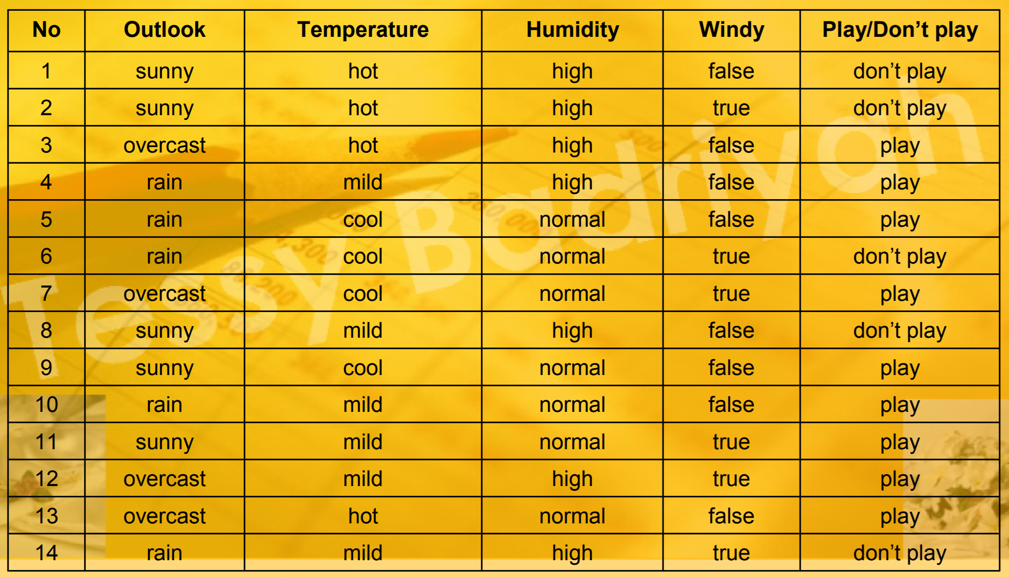
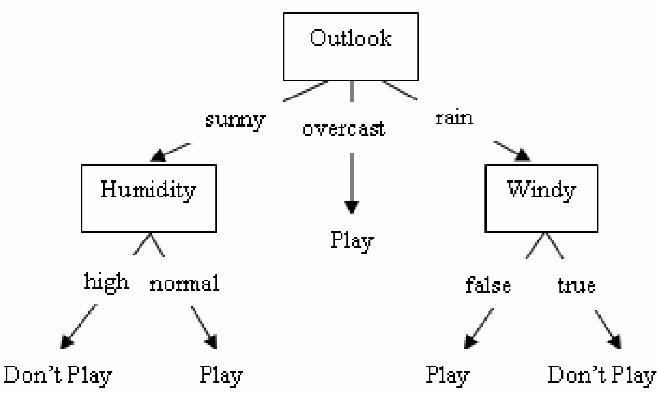
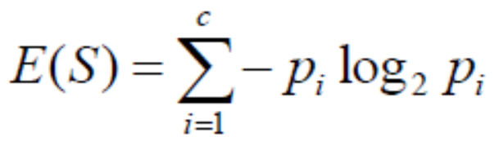
Decision Tree:

Slide 3
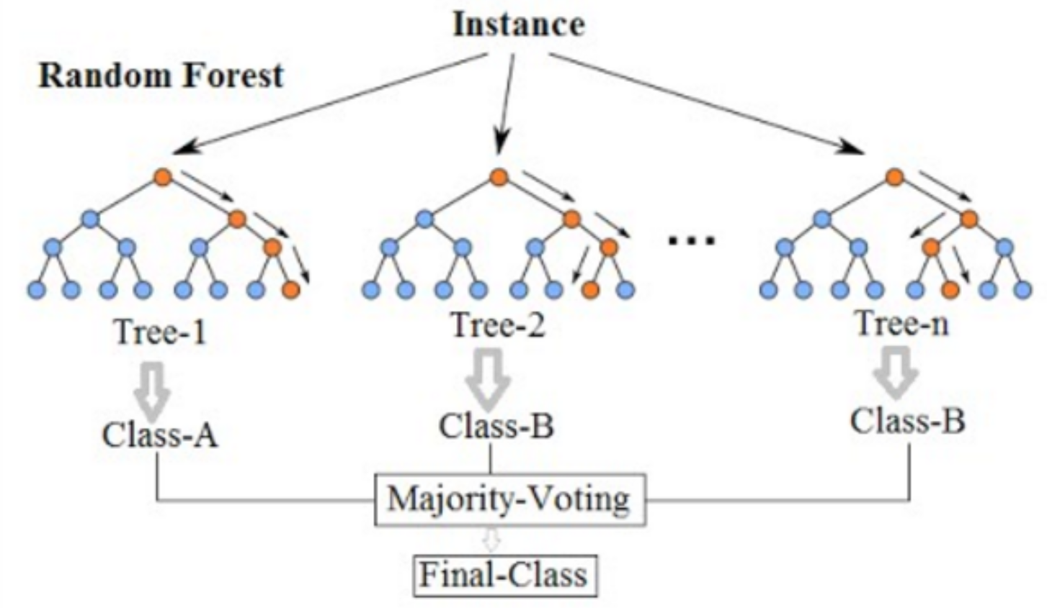
Random Forest:
Notes:
First Step : Create random vectors
Second Step : Use random vector to build multiple decision trees
Third Step : Combine decision trees

Slide 4
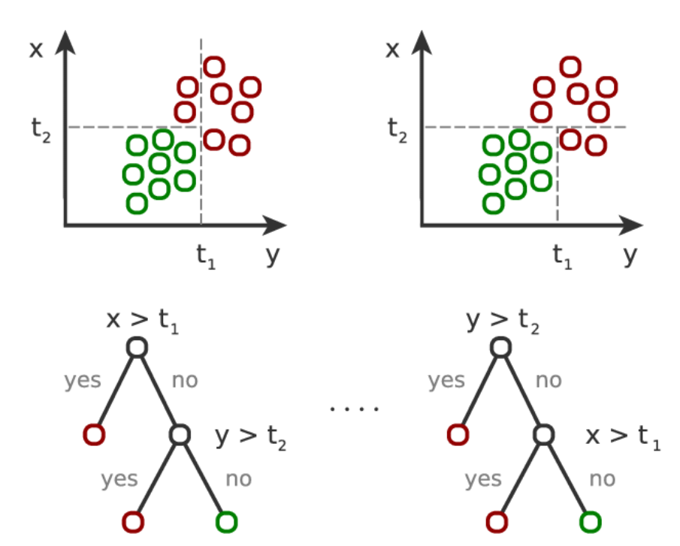
Random Forest:
Classification

Slide 5
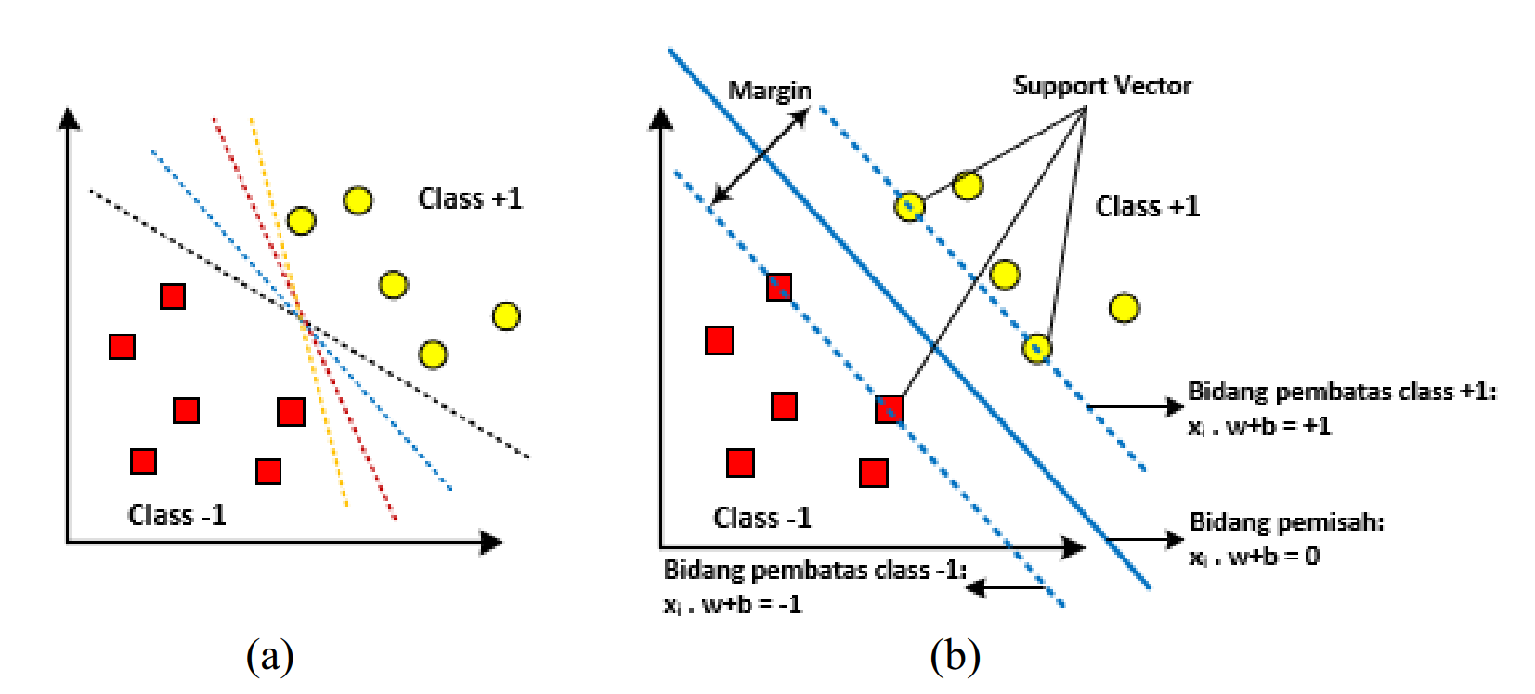
Support Vector Machine:
Classification

Slide 6
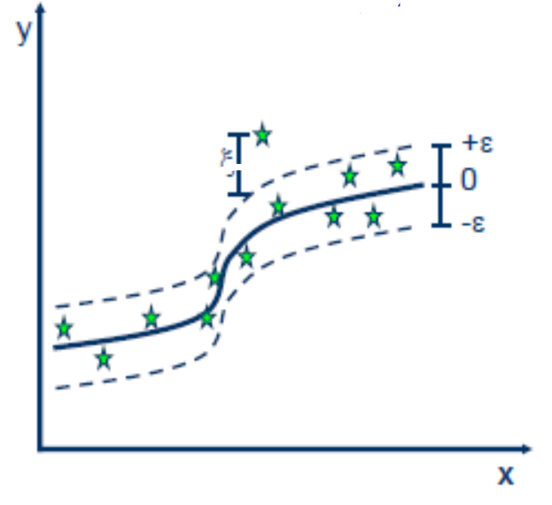
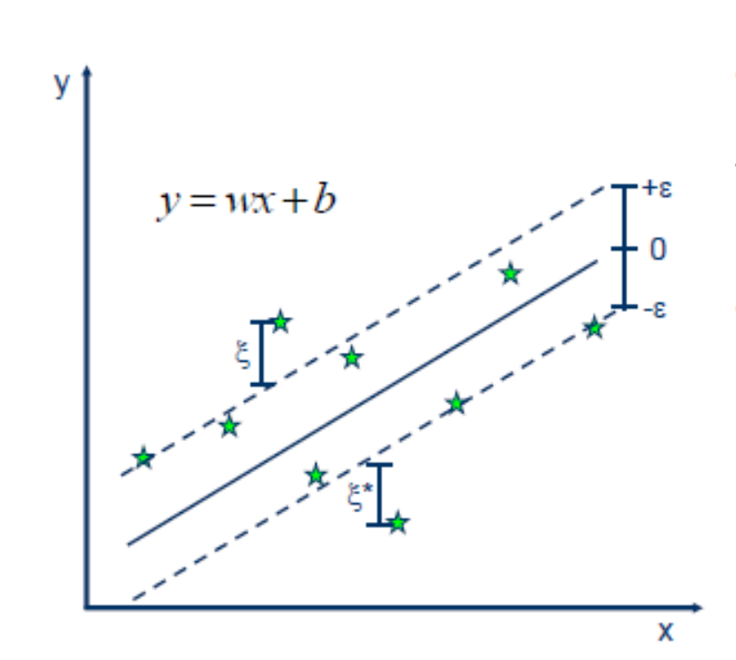
Regression
Linear Vs Non-Linear

Slide 7
FRCI on Agroforestry (Cidanau)
FRCI calculated using LiDAR data
800 Sample data
Divide Data (Training and testing data)
Data Normalization (Feature Scaling)
K-fold cross validation
Model predicted using Random Forest Regression
Model predicted using SVR (Support Vector Regression)

Slide 8
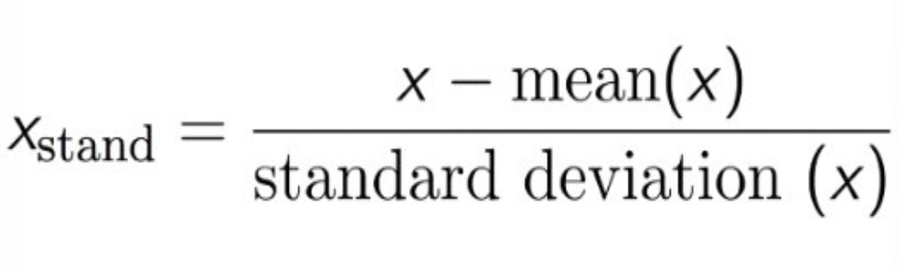
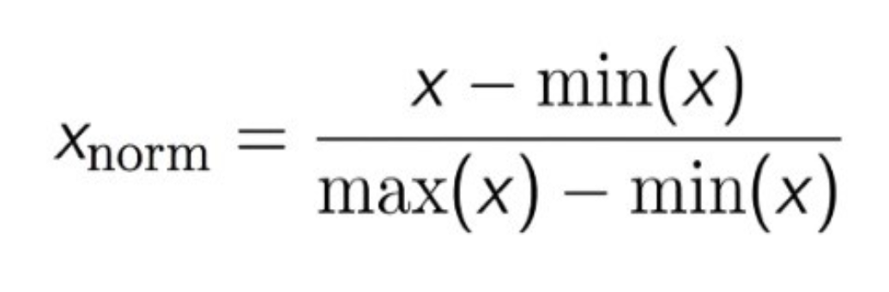
Normalisasi Data with StandardScaler
http://benalexkeen.com/feature-scaling-with-scikit-learn/
https://scikit-learn.org/stable/modules/generated/sklearn.preprocessing.StandardScaler.html

Slide 9
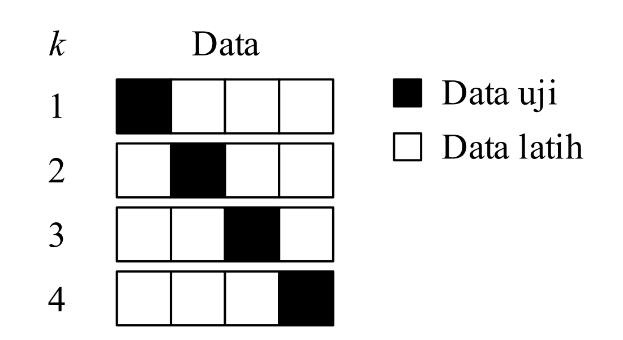
K-Fold Cross Validation

Slide 10
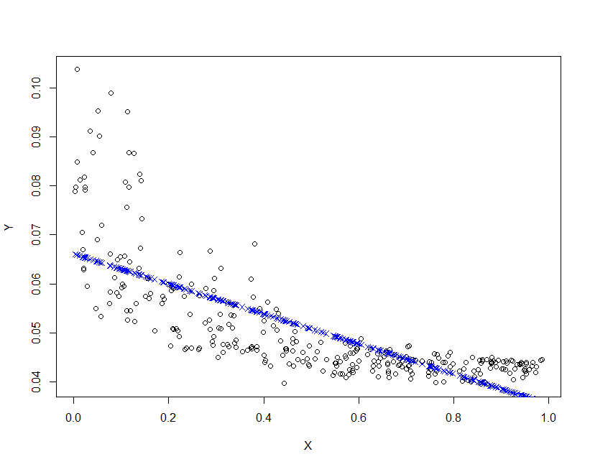
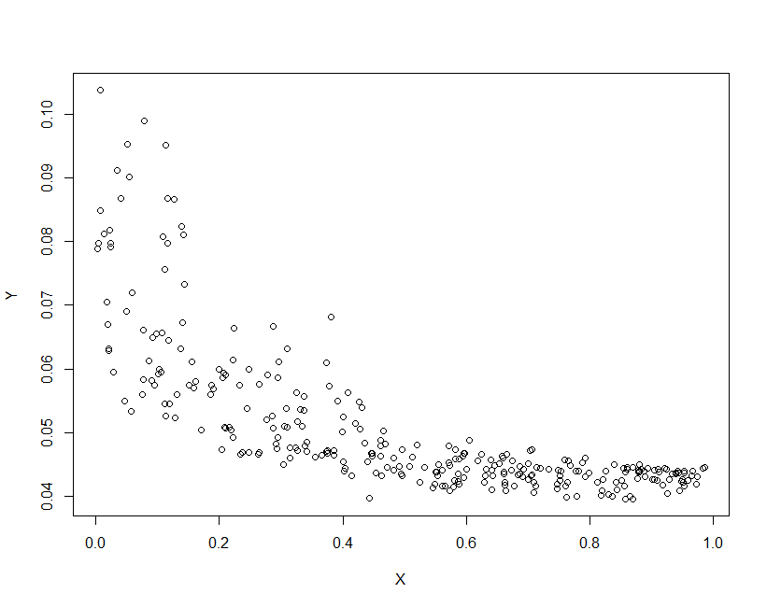
Prediction Model…[1]
Linear Model
RMSE : 0.008028042
FRCI VS Band 4

Slide 11
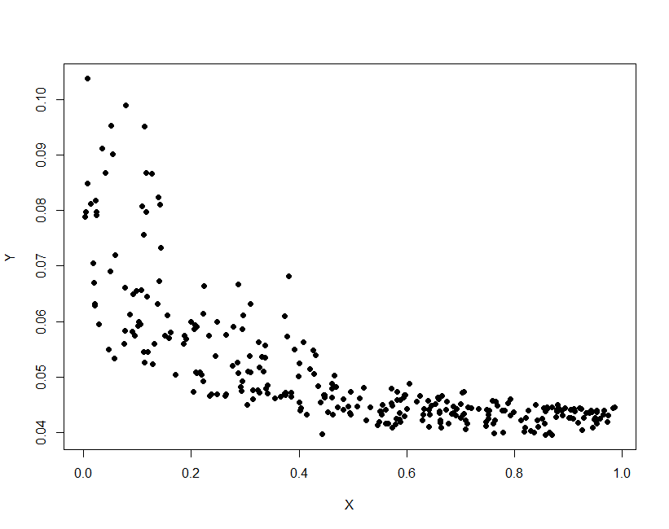
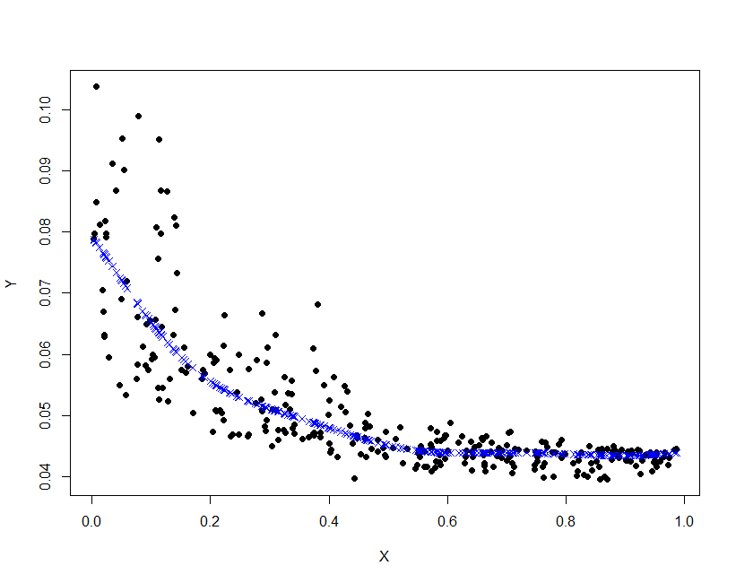
Prediction Model…[2]
SVM
RMSE :0.00645505

Slide 12
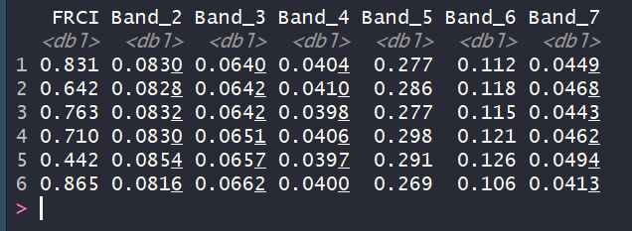
Prediction Model…[3]
SVM
RMSE :0.1188936

Slide 13
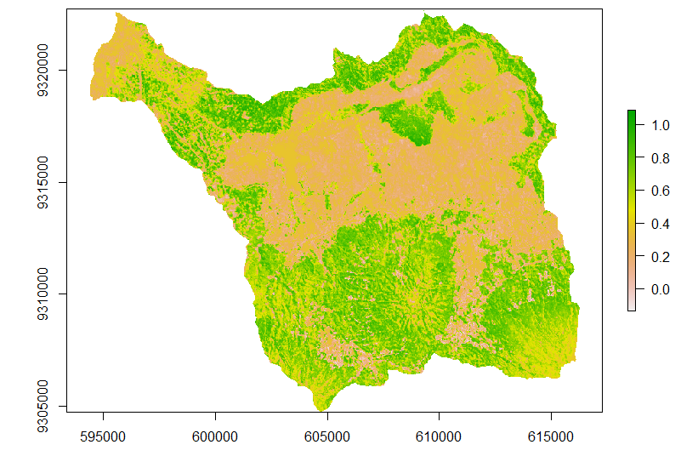
Prediction Map of FRCI

Slide 14
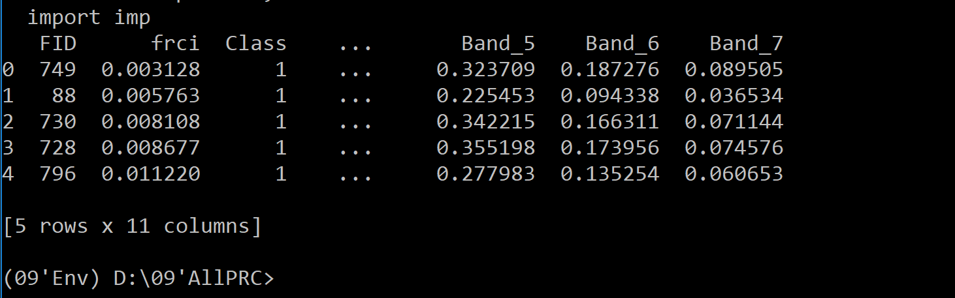
Prediction Canopy Cover Percentage using Random Forest…[5]
Random Forest
RMSE :0.1668799

